Slide 1

YSR ENGINEERING COLLEGE OF YOGI VEMANA UNIVERSITY
DEPARTMENT OF COMPUTER SCIENCE AND ENGINEERING
Project presentation
on
A DEEP LEARNING APPROACH FOR PAPAYA LEAF DISEASE DETECTON AND CLASSIFICATION USING RESNET 18 CBAM
by
Team Members
Project Guide
Mrs. S. Hema Sri,
M. Tech, (Ph.D.)
Academic Consultant,
Department Of CSE.
Prof. C. Nagaraju,
Head of the Department,
Computer Science and Engineering.
S.R. Siddu Sai Triveni (1012202024)
B. Prashanthi(1012202018)
M. Sravya(1012202028)
P. Adarsh(1012202001)

Slide 2
CONTENTS
ABSTRACT
INTRODUCTION
LITERATURE SURVEY
EXISTING METHODS
LIMITATIONS OF EXISTING METHODS
PROPOSED METHOD
RESULT AND ANALYSIS
CONCLUSION

Slide 3
ABSTRACT

Slide 4
Papaya is an important agricultural crop that is affected by several diseases . These disease can reduce crop yield and overall plant health.
Traditional disease detection methods rely on manual inspection, which can be time-consuming and sometimes inaccurate.
A deep learning approach is used for papaya leaf disease classification using leaf image analysis.
The proposed model uses ResNet-18 integrated with the CBAM attention module to improve feature extraction and classification performance.
Experimental results show that the model achieves high accuracy in identifying multiple papaya leaf diseases.
This approach can support early disease diagnosis and improved crop management.

Slide 5
INTRODUCTION

Slide 6
Agriculture is an essential sector that supports global food production and economic development.
Papaya is a widely cultivated tropical fruit crop known for its high nutritional and commercial value.
However, papaya plants are often affected by several leaf diseases that negatively impact plant health, growth, and crop yield.
Therefore, early identification and analysis of papaya leaf diseases are important for improving crop management and agricultural productivity.
Recent advancements in artificial intelligence and deep learning have enabled the development of image-based techniques for accurate plant disease identification.

Slide 7
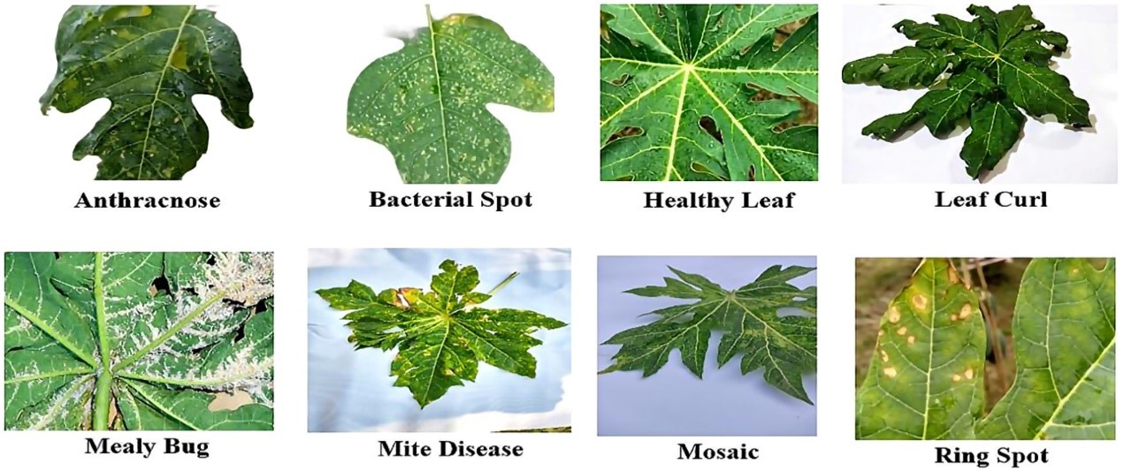
Papaya plants are affected by several diseases that damage leaf structure and reduce plant productivity.
These diseases cause symptoms such as spots, discoloration, curling, and deformation of leaves. If these diseases are not identified at an early stage, they can spread quickly and significantly reduce crop yield.
Some of the common papaya leaf diseases include Anthracnose, Bacterial Spot, Leaf Curl,
Healthy, Ring Spot, Mite Disease, Mealy Bug, Mosaic, Ring Spot.
Fig :Sample Images of Papaya Leaf Diseases such as Anthracnose, Bacterial Spot, Leaf Curl, Mealy Bug, Mite Disease, Mosaic, Ring Spot, and Healthy Leaf.

Slide 8
Challenges in Papaya Leaf Disease Detection
Many diseases show similar visual symptoms, making manual identification difficult.
Variations in lighting, background, and leaf shape affect disease recognition.
Early disease symptoms are often small and difficult to observe visually.
Role of Deep Learning
Deep learning models can automatically learn disease patterns from images. They help in accurate and fast classification of plant diseases.
Convolutional Neural Networks (CNNs) are effective in extracting important image features. These techniques improve disease detection accuracy and support agricultural decision making.

Slide 9
LITERATURE SURVEY

Slide 10
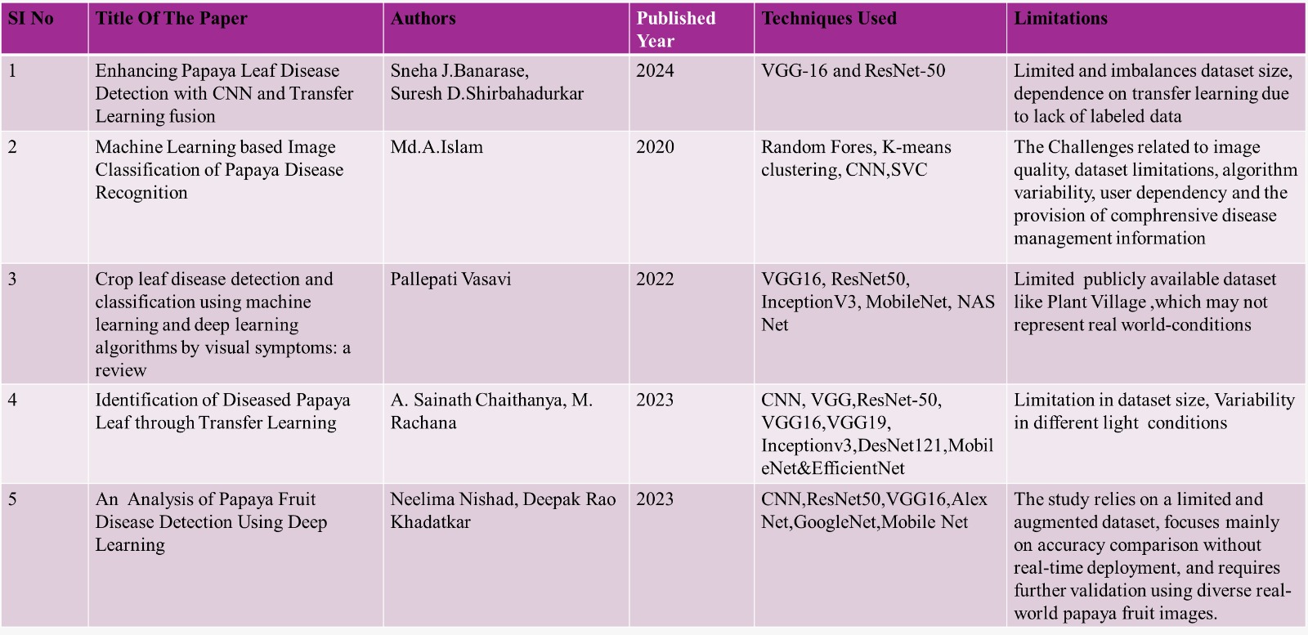

Slide 11
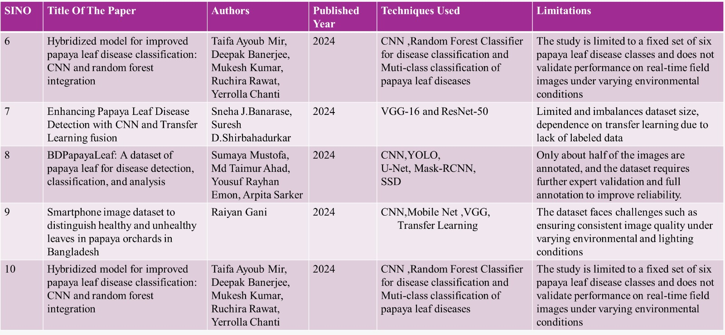

Slide 12
EXISTING METHODS

Slide 13
The existing system uses deep learning models to detect papaya leaf diseases from leaf images.
Two convolutional neural network architectures, VGG16 and ResNet50, are used for disease classification. These models analyze papaya leaf images to identify disease patterns and classify them into categories such as Anthracnose, Bacterial Spot, Curl, Mosaic, and Ring Spot.
The system processes leaf images using preprocessing techniques and extracts important features for accurate disease identification.
In addition to disease detection, the system also integrates an automated pesticide spraying mechanism, where the identified disease information is used to activate a robotic sprayer that targets the infected areas of the plant, helping to reduce pesticide wastage and improve farming efficiency.

Slide 14
Vgg16 Model
VGG16 is a deep convolutional neural network widely used for image classification tasks.
It uses small 3×3 convolution filters to capture important visual features from images.
The architecture consists of multiple convolution layers followed by ReLU activation and max-pooling layers.
After feature extraction, fully connected layers perform the final classification of papaya leaf diseases.
In the existing system, VGG16 is used to identify different papaya leaf diseases based on leaf image patterns.

Slide 15
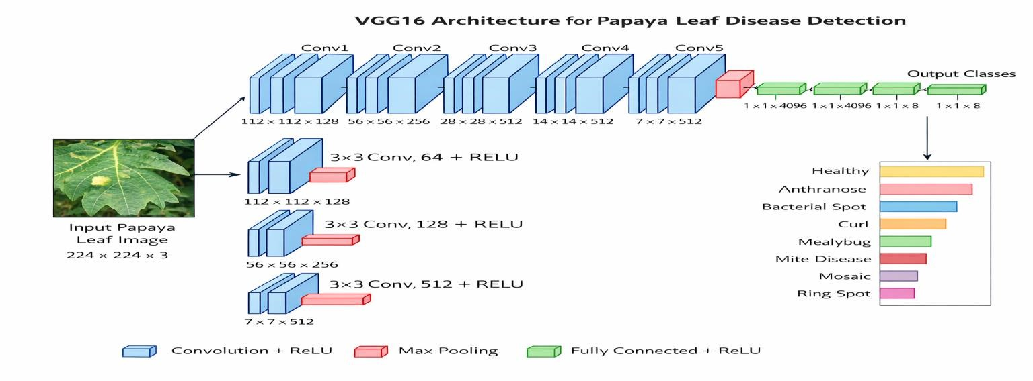
Architecture Of Vgg16
The VGG16 architecture takes a 224 × 224 RGB papaya leaf image as input and processes it through five convolutional blocks with 3 × 3 filters and ReLU activation to extract features like texture and disease patterns. Max pooling reduces the feature size, and the extracted features are passed through fully connected layers. Finally, a Softmax layer classifies the leaf into different disease categories. This deep architecture helps in capturing both low-level and high-level features effectively. It improves the accuracy of detecting and classifying multiple papaya leaf diseases.
Fig:VGG16 Architecture diagram for Papaya Leaf Disease Detection

Slide 16
ResNet50 Model
ResNet50 is a deep convolutional neural network used for advanced image recognition tasks.
It introduces residual learning and skip connections to overcome the vanishing gradient problem.
The architecture contains multiple residual blocks that help the network learn deeper features from images.
It extracts complex patterns from papaya leaf images for accurate disease detection.
The final fully connected and SoftMax layers classify the leaf into different disease categories.

Slide 17
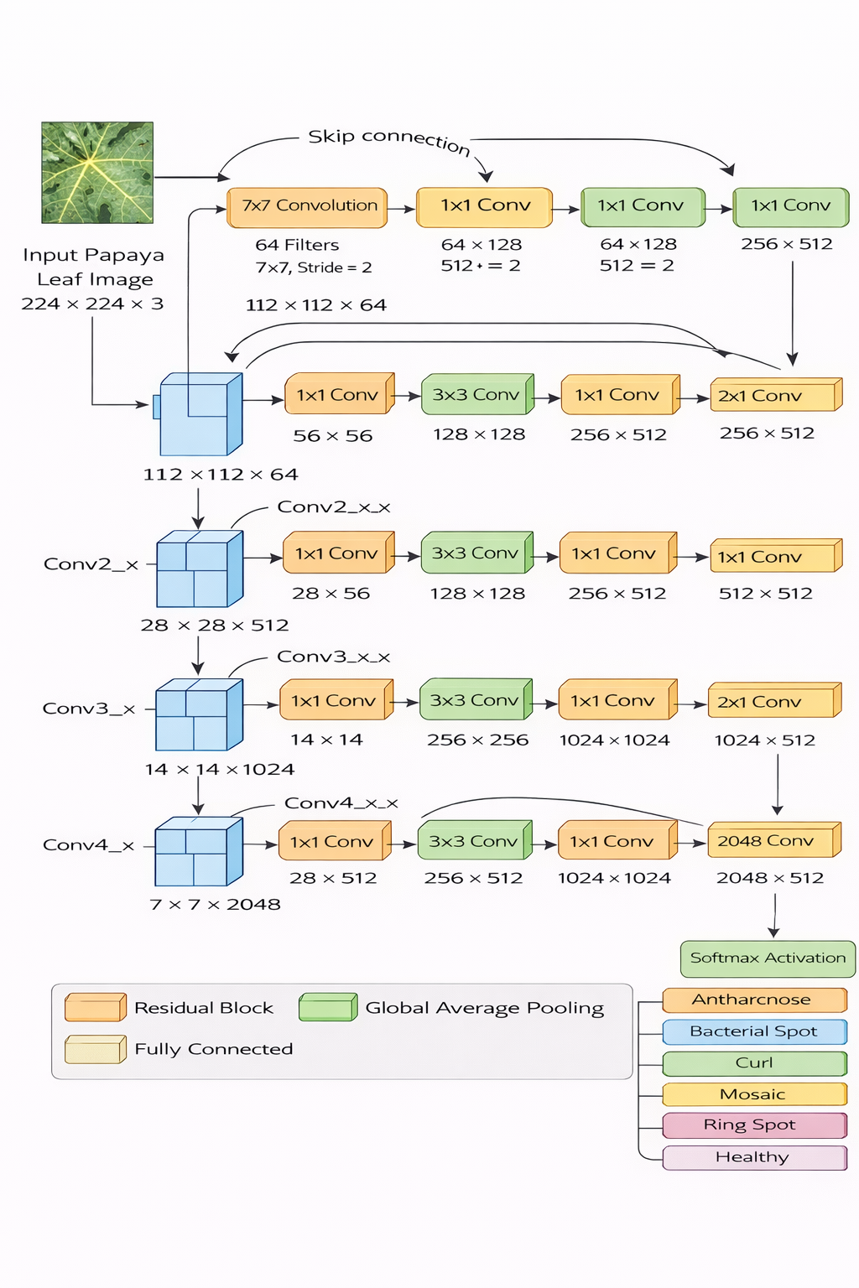
Architecture Of ResNet50
The ResNet-50 architecture takes a 224 × 224 RGB papaya leaf image as input and processes it through an initial 7 × 7 convolution layer with 64 filters, followed by max pooling. The network uses residual blocks with skip connections, which help in training deep networks by avoiding gradient vanishing. Each block follows a bottleneck structure (1×1, 3×3, 1×1 convolutions) to extract deep and complex features related to disease patterns. After feature extraction, global average pooling reduces the feature maps, and the output is passed through fully connected layers. Finally, a Softmax layer classifies the leaf into different disease categories.
Fig:ResNet-50 Architecture for Papaya Leaf Disease Detection

Slide 18
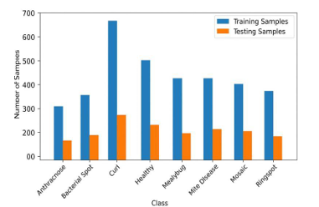
Dataset Used In Existing Methods
The dataset contains 3,626 papaya leaf images.
Images are categorized into eight classes such as Anthracnose, Bacterial Spot, Curl, Healthy, Mealybug, Mite Disease, Mosaic, and Ring Spot.
The dataset is divided into 80% training and 20% testing images.
Images are preprocessed to improve classification performance.
Fig: Dataset Distribution of Papaya Leaf Images for Training and Testing

Slide 19
Limitations Of Existing Methods
Existing models such as VGG16 and ResNet50 require high computational resources for training and deployment.
The system performance may decrease under varying lighting conditions or complex backgrounds.
The automated spraying mechanism requires additional hardware setup and maintenance.
The models are limited to detecting only the diseases included in the training dataset.
Large datasets and long training time are required for accurate disease classification.

Slide 20
PROPOSED METHOD

Slide 21
The proposed system uses ResNet-18 integrated with the Convolutional Block Attention Module (CBAM) for papaya leaf disease classification.
The model analyzes papaya leaf images and extracts important visual features such as color patterns, textures, and disease spots.
The CBAM attention mechanism helps the model focus on the most relevant regions of the leaf image.
Image preprocessing techniques such as resizing, normalization, and augmentation are applied to improve model performance.
The trained model classifies the leaf images into different disease categories and healthy leaves.

Slide 22
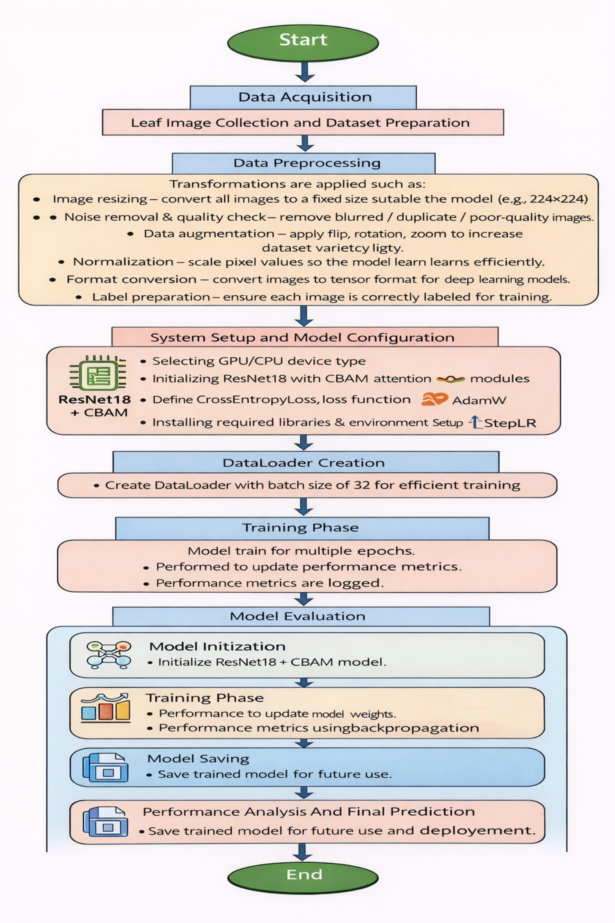
Workflow Flow Of Resnet-18 Cbam

Slide 23
Data Acquisition: Papaya leaf images are collected from the dataset containing multiple disease categories such as Anthracnose, Bacterial Spot, Curl, Healthy, Mealybug, Mite Disease, Mosaic, and Ring Spot.
Image Preprocessing: The collected images are preprocessed before training. This includes resizing the images to 224 × 224 pixels, normalization of pixel values, and data augmentation techniques such as rotation, flipping, and color adjustments to improve model generalization.
System Setup and Model Configuration: The system is configured by selecting the appropriate GPU/CPU device. The ResNet18 model integrated with CBAM attention modules is initialized, and required libraries are loaded. The loss function (CrossEntropyLoss), optimizer (AdamW), and learning rate scheduler (StepLR) are defined.

Slide 24
DataLoader Creation: The preprocessed images are converted into batches using DataLoader with a batch size of 32, enabling efficient data handling during training and validation.
Training Phase:The model is trained for multiple epochs using pretrained weights. During training, forward propagation, loss computation, and backpropagation are performed to update model weights and improve performance.
Model Evaluation:After training, the model is evaluated using validation data to assess its performance and generalization capability on unseen images.
Performance Analysis and Final Prediction: The model generates predictions, and performance is analyzed using metrics such as accuracy, confusion matrix, and classification report. The final disease label is displayed.
Model Saving: Finally, the trained model is saved for future use and deployment in papaya leaf disease detection systems.

Slide 25
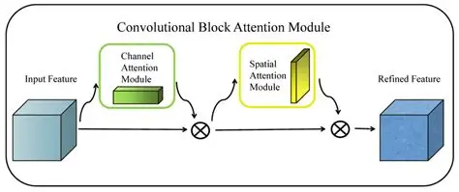
Convolutional Block Attention Module
CBAM is an attention mechanism used to improve the feature extraction ability of convolutional neural networks.
It works by applying two sequential attention modules:
Channel Attention and Spatial Attention.
Channel Attention focuses on what features are important in the feature map.
Spatial Attention focuses on where the important information is located in the image.
By integrating CBAM with ResNet-18, the network can highlight important disease regions in papaya leaf images and improve classification performance.
Fig: Convolutional Block Attention Module

Slide 26
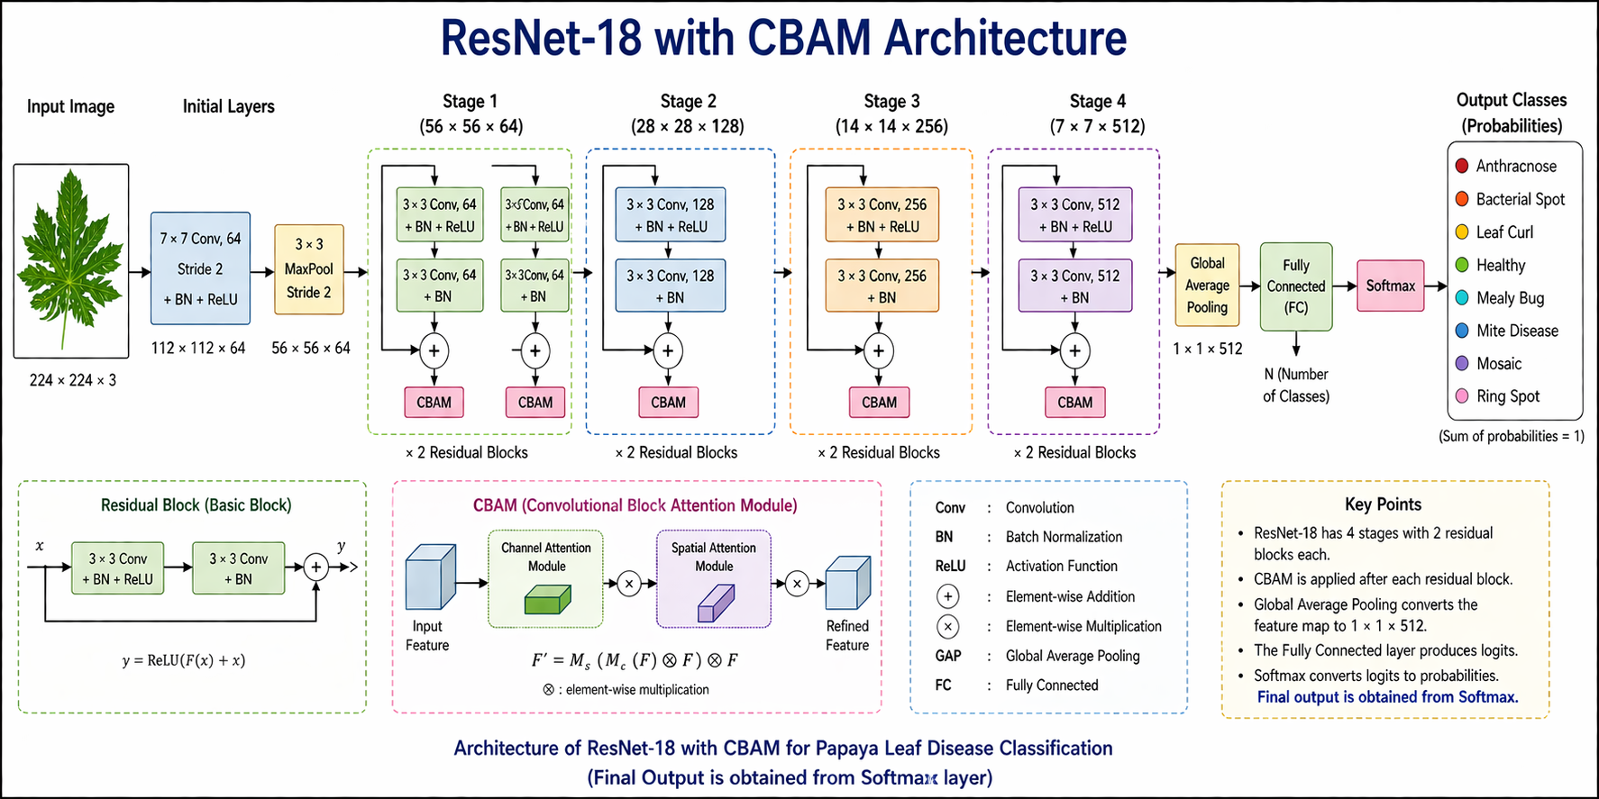
Architecture of ResNet-18 CBAM
Fig: Architecture of ResNet-18 with CBAM for Papaya Leaf Disease Classification

Slide 27
The input papaya leaf image (224 × 224 × 3) is processed through convolution and pooling layers to extract basic visual features.
The ResNet-18 residual blocks enable deep feature extraction while avoiding the vanishing gradient problem using skip connections.
The CBAM module enhances feature learning by applying channel and spatial attention to focus on important regions of the leaf.
Global average pooling and a fully connected layer classify the image, and the Softmax layer outputs probabilities for eight disease categories.

Slide 28
Training Configuration
Optimizer
AdamW Optimizer is used for training the model with a learning rate of 0.0001.
It improves learning efficiency and prevents overfitting by applying weight decay during optimization.
Activation Functions
ReLU (Rectified Linear Unit) is used in convolution layers to introduce non-linearity.
Sigmoid Activation Function is used inside the CBAM attention module for attention map generation.
Softmax Activation Function is used in the final layer to classify papaya leaf images into different disease categories.
Loss Function
Cross-Entropy Loss is used as the loss function for multi-class classification.
It measures the difference between the predicted probabilities and the actual class labels.

Slide 29
Hyperparameters Configuration And Comparison Of The Proposed Method
Hyperparameter | Your Implementation | Default / Standard (ResNet18) | Purpose / Impact
Image Size | 224 × 224 | 224 × 224 | Standard input size
Batch Size | 32 | 16 / 32 | Balanced training speed & memory
Data Augmentation | Flip, Rotation (20°), Color Jitter | Minimal / None | Improves generalization
Normalization | ImageNet mean & std | Same | Better convergence
Model Architecture | ResNet18 + CBAM | ResNet18 | Improves feature attention
Attention Module | CBAM (4 layers) | Not used | Enhances important features
Loss Function | CrossEntropyLoss | Same | Multi-class classification

Slide 30
Hyperparameter | Your Implementation | Default / Standard (ResNet18) | Purpose / Impact
Optimizer | AdamW | SGD / Adam | Better regularization
Learning Rate | 1e-4 | 1e-3 | Stable training
Weight Decay | 1e-4 | 0 / 1e-5 | Prevents overfitting
LR Scheduler | StepLR (step=10, gamma=0.1) | Not always used | Adjusts learning rate
Epochs | 25 | 10–20 | Better learning
Shuffle | Enabled (train) | Sometimes | Improves randomness
Pretrained Weights | ImageNet | Optional | Faster convergence
Output Layer | Fully connected (512 → num_classes) | Same | Classification layer

Slide 31
Hardware Requirements
Processor (CPU):
Intel Core i7 (11th Gen)
RAM:
Minimum: 8 GB
Recommended: 8 GB or above
Storage:
Minimum: 20 GB free space (for dataset and model)
Graphics (GPU):
Integrated Intel Graphics (CPU-based training)
System Type:
64-bit Operating System (x64-based PC)

Slide 32
Software Requirements
Operating System:
Windows 11 (64-bit)
Programming Language:
Python (Version 3.10)
Libraries & Frameworks:
PyTorch (for deep learning model – ResNet-18 with CBAM)
Torchvision (for image processing and pretrained models)
NumPy (for numerical computations)
Matplotlib (for plotting graphs)
Scikit-learn (for evaluation metrics: accuracy, precision, recall, F1-score)
PIL (for image handling)
Development Tools: VS Code

Slide 33
RESULTS AND ANALYSIS

Slide 34
The performance of the proposed ResNet-18 with CBAM model was evaluated using precision, recall, F1-score, and accuracy metrics.
The experimental results show that the model achieves high classification performance across all papaya leaf disease classes.
The integration of the CBAM attention module helps the model focus on important disease regions, improving feature extraction.
The experimental results demonstrate that the proposed model achieves high classification performance across all disease categories.

Slide 35
Comparing Accuracy for Existing Method and Predicted Method Result
The table compares the classification accuracy of existing models (VGG16 and ResNet50) with the proposed ResNet-18 with CBAM model.
The proposed ResNet-18 with CBAM model achieves higher classification accuracy across most papaya leaf disease classes by improving feature learning through the attention mechanism.
Predicted Result
Name of the Disease | Existing Method Result Accuracy(%) |  | Proposed Method Accuracy(%) ResNet-18 with CBAM
 | VGG 16 | RESNET 50
Anthracnose | 90 | 92 | 100
Bacterial Spot | 88 | 91 | 95.53
LeafCurl | 86 | 93 | 98.46
Healthy | 93 | 98 | 99.66
Mealy bug | 95 | 90 | 100
Mite Disease | 92 | 89 | 97.28
Mosaic | 94 | 91 | 97.80
Ring Spot | 89 | 90 | 99.43

Slide 36
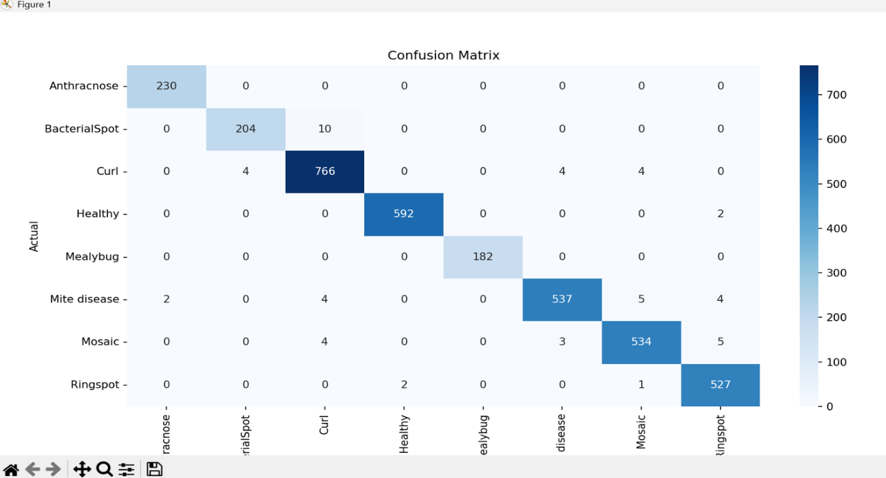
Confusion Matrix
The confusion matrix shows the comparison between actual and predicted papaya leaf disease classes. Most values appear along the diagonal of the matrix, indicating that the majority of samples are correctly classified by the model. Very few misclassifications are observed between certain disease classes due to similar visual features.
Fig :Confusion Matrix for Papaya Leaf Disease Classification

Slide 37
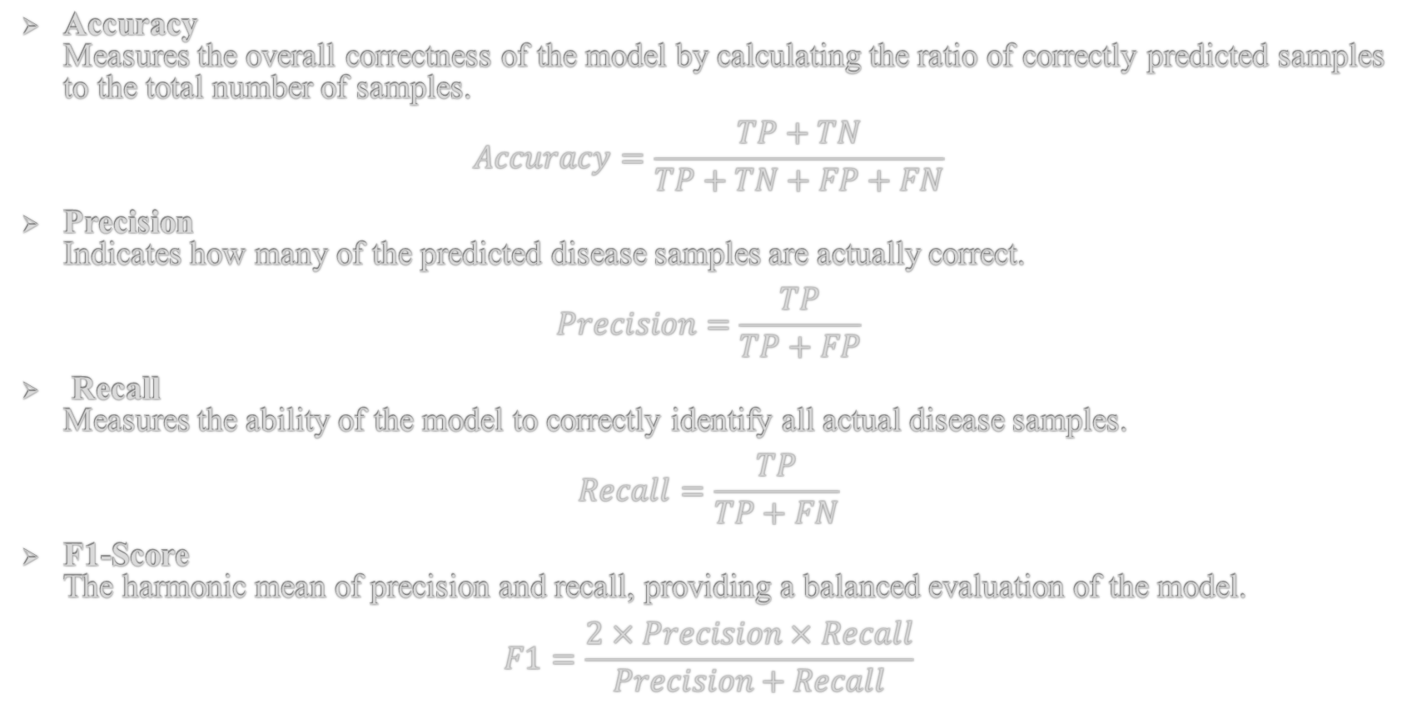
Evaluation Metrics
Accuracy
Measures the overall correctness of the model by calculating the ratio of correctly predicted samples to the total number of samples.
$$Accuracy=\frac{TP+TN}{TP+TN+FP+FN}$$
Precision
Indicates how many of the predicted disease samples are actually correct.
$$Precision=\frac{TP}{TP+FP}$$
Recall
Measures the ability of the model to correctly identify all actual disease samples.
$$Recall=\frac{TP}{TP+FN}$$
F1-Score
The harmonic mean of precision and recall, providing a balanced evaluation of the model.
$$F1=\frac{2×Precision×Recall}{Precision+Recall}$$

Slide 38
Comparing Precision, Recall, F1-Score for Existing Method and Predicted Method Result
This table compares the performance of existing models (VGG16, ResNet50) with the proposed ResNet18-CBAM model across different disease classes using Precision, Recall, and F1-Score.The proposed model consistently achieves higher accuracy and balanced performance, demonstrating its effectiveness for reliable disease classification.
Class Name | Precision |  |  | Recall |  |  | Fl-Score
 | Existing methods |  | Proposed method ResNet18 Cbam | Existing Methods |  | Proposed Method ResNet18 Cbam
 |  |  |  |  |  |  | Existing Methods |  | Proposed Method ResNet18 Cbam
 | vgg16 | ResNet50 |  | vgg16 | ResNet50 |  | vgg16 | ResNet50
Anthracnose | 91 | 89 | 99.14 | 88 | 87 | 100 | 88 | 88 | 99.57
Bacterial Spot | 89 | 85 | 98.06 | 85 | 84 | 95.33 | 85 | 84 | 96.68
LeafCurl | 87 | 90 | 97.70 | 85 | 88 | 98.46 | 85 | 89 | 98.08
Healthy | 94 | 95 | 99.66 | 91 | 97 | 99.66 | 91 | 96 | 99.66
Mealy bug | 94 | 83 | 100 | 95 | 82 | 100 | 94 | 82 | 100
Mite Disease | 91 | 81 | 98.71 | 92 | 80 | 97.28 | 92 | 80 | 97.99
Mosaic | 93 | 88 | 98.16 | 94 | 87 | 97.86 | 93 | 87 | 97.98
Ring Spot | 85 | 86 | 97.96 | 84 | 85 | 99.43 | 94 | 85 | 98.69

Slide 39
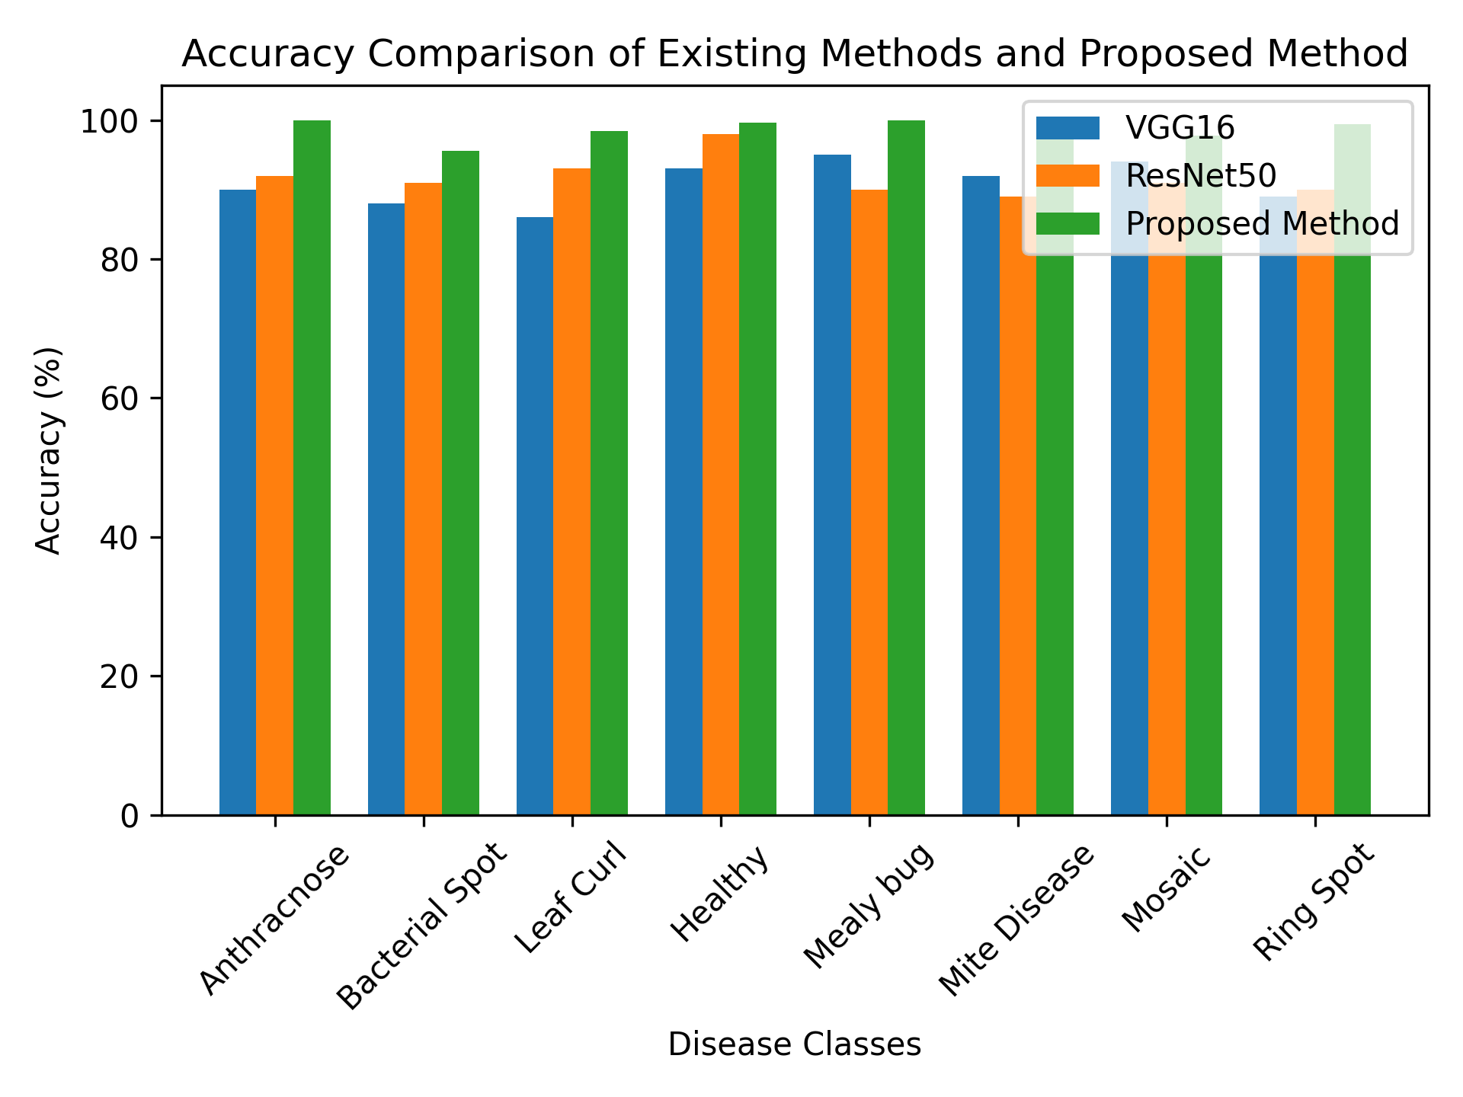
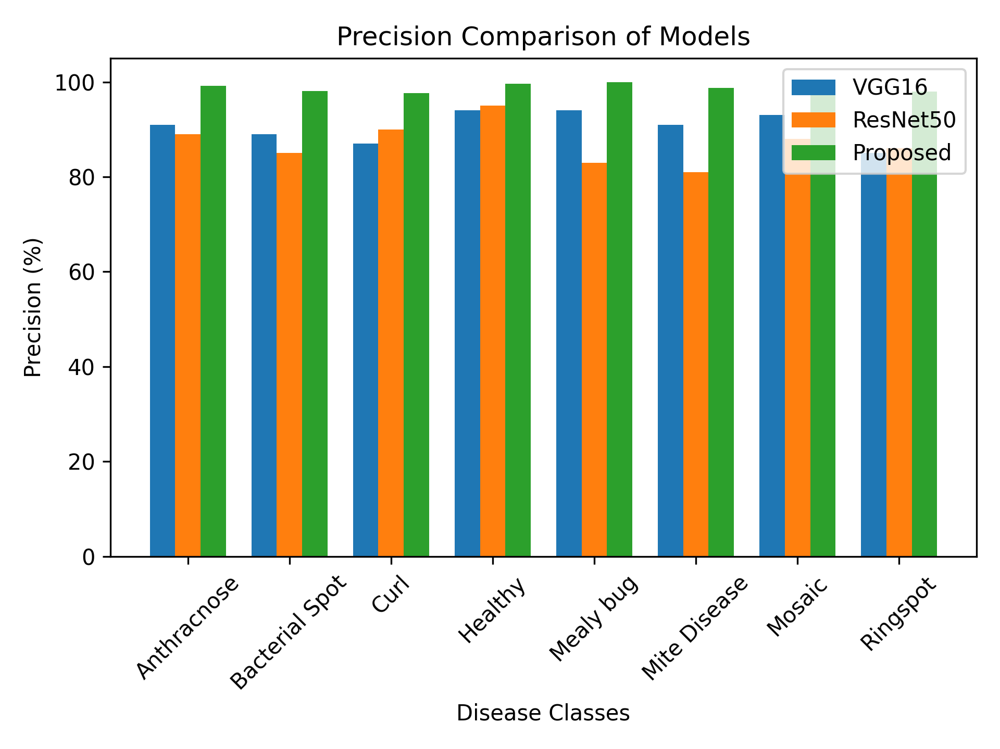
Accuracy and Precision Comparison of Existing and Proposed Method
The proposed ResNet-18 with CBAM model achieves high accuracy across all papaya leaf disease classes.
Precision values are consistently high, indicating that the model makes very few false positive predictions.
Compared to existing models, the proposed model shows improved performance in most disease categories.
High accuracy and precision demonstrate the model’s ability to correctly classify papaya leaf diseases.

Slide 40


Recall and F1-Score Comparison of Existing and Proposed Methods
The recall values indicate that the model successfully identifies most of the actual disease cases.
High recall ensures minimum false negatives, which is important for disease detection.
The F1-score provides a balance between precision and recall, showing overall model effectiveness.
The proposed model achieves high F1-scores across all classes, confirming reliable classification performance.

Slide 41
CONCLUSION AND FUTURE SCOPE

Slide 42
CONCLUSION
A deep learning–based papaya leaf disease classification system was developed using the ResNet-18 architecture integrated with the CBAM attention module.
The model was trained and evaluated on papaya leaf images belonging to eight disease categories.
Experimental results show that the proposed model achieved high precision, recall, F1-score, and overall classification accuracy.
The integration of the CBAM attention mechanism improved feature extraction and disease recognition performance.
The developed system demonstrates the effectiveness of deep learning techniques for accurate papaya leaf disease detection.

Slide 43
FUTURE SCOPE
The proposed model can be extended to develop a mobile or web application for real-time papaya leaf disease detection.
The system can be integrated with smart agricultural tools such as drones or IoT devices for large-scale crop monitoring.
Future work can include detecting additional plant diseases and other crop species using the same approach.
Real-time disease detection systems can help farmers take early preventive actions and improve crop productivity.

Slide 44
ANY QUERIES ?

Slide 45
THANK YOU
*********************

